Slide 1
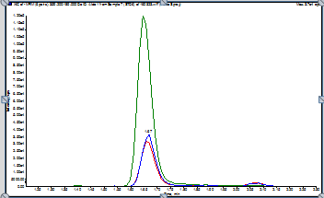
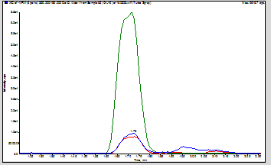
TROUBLESHOOTING POSTER TEMPLATE
PROBLEM
TROUBLESHOOTING STEPS TAKEN
Now, let’s try to fix it!
METHOD INFORMATION
Figure 1: Good Chromatogram at beginning of run
OUTCOME
Figure 2: Chromatogram with obvious peak shape issues towards end of run

